Slide 1
Sudoku Solver
Ingo Prötel, Christoph Hanke, Benjamin Müller

Slide 2
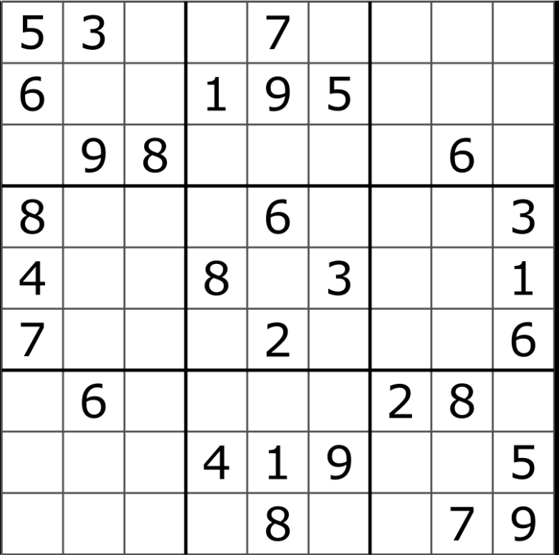
Introduction Sudoku
Fill in the digits 1 - 9 so that
each row and
each column and
each 3x3 sub-grid
contains each digit exactly once.

Slide 3
Data
Four different datasets from Kaggle:
https://www.kaggle.com/datasets/bryanpark/sudoku 1 million puzzles
https://www.kaggle.com/datasets/rohanrao/sudoku 9 million puzzles
https://www.kaggle.com/datasets/radcliffe/3-million-sudoku-puzzles-with-ratings 3 million puzzles
https://www.kaggle.com/datasets/informoney/4-million-sudoku-puzzles-easytohard 4 million puzzles

Slide 4
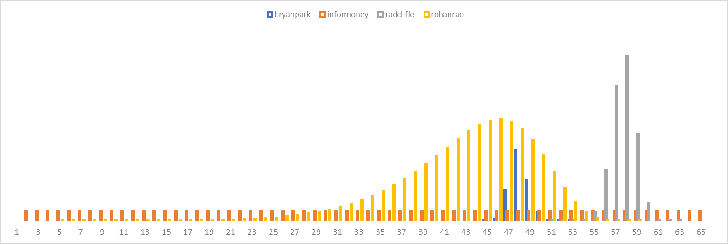
Data Content
17 000 000 solutions are 16 999 295 unique
between 1 - 64 missing digits

Slide 5
Base Model
Convolutional Neural Network-based Sudoku Solver
Sudokus are zero mean-centred normalized ( [-0.5, .05] ) and represented by a (9,9,1)-Tensor
the model transforms every sudoku field into a multi-class classification of size 9
-> size of probability tensor is 81x9 which is converted to a 9x9 solution tensor using softmax
Loss function is sparse_categorical_crossentropy

Slide 6
Base Model
keras.models.Sequential([
Conv2D(filters=64, kernel_size=(3,3), activation="relu", padding='same', input_shape=(9,9,1)),
BatchNormalization(),
Conv2D(filters=64, kernel_size=(3,3), activation="relu", padding='same'),
BatchNormalization(),
Conv2D(filters=128, kernel_size=(1,1), activation="relu", padding='same'),
Flatten(),
Dense(81*9),
Reshape((-1, 9)),
Activation('softmax')
])

Slide 7
Base Model
First approach: predict everything at once
-> bad performance
Second approach: predict only one field per iteration
take the value with highest probability and start all over again with n+1 given values
human centered approach
takes very long (~ 20 seconds per sudoku)
higher reliability (99% on certain datasets)

Slide 8
Sums and Products
How to improve this already good base model?
Looking for ways to make it faster and/or even more reliable
Let’s support the model with additional information!
every column and row has a sum of 45 ( ∑ i=[1;9] )
every column and row has a product of 362.880 ( ∏ i=[1;9] )
expand the 9x9 tensor to a 10x10 resp. 11x11 tensor
Idea: the CNN uses some kind of linear regression which is interwoven to the inference process

Slide 9
Sums and Products
Unsolved Sudoku:
[ 0 0 4 3 0 0 2 0 9 18]
[ 0 0 5 0 0 9 0 0 1 15]
[ 0 7 0 0 6 0 0 4 3 20]
[ 0 0 6 0 0 2 0 8 7 23]
[ 1 9 0 0 0 7 4 0 0 21]
[ 0 5 0 0 8 3 0 0 0 16]
[ 6 0 0 0 0 0 1 0 5 12]
[ 0 0 3 5 0 8 6 9 0 31]
[ 0 4 2 9 1 0 3 0 0 19]
[ 7 25 20 17 15 29 16 21 25 0]
Correct Sudoku:
[ 8 6 4 3 7 1 2 5 9 45]
[ 3 2 5 8 4 9 7 6 1 45]
[ 9 7 1 2 6 5 8 4 3 45]
[ 4 3 6 1 9 2 5 8 7 45]
[ 1 9 8 6 5 7 4 3 2 45]
[ 2 5 7 4 8 3 9 1 6 45]
[ 6 8 9 7 3 4 1 2 5 45]
[ 7 1 3 5 2 8 6 9 4 45]
[ 5 4 2 9 1 6 3 7 8 45]
[45 45 45 45 45 45 45 45 45 0]

Slide 10
Sums and Products
Difficulties:
Model becomes quite big:
model.add(Dense(81*9)) #(9x9x9)
-> model.add(Dense(100*45)) #(10x10x45)
-> model.add(Dense(121*362.880)) #(11x11x362.880)

Slide 11
Sums and Products
Difficulties:
Model becomes quite big:
model.add(Dense(81*9)) #(9x9x9)
-> model.add(Dense(100*45)) #(10x10x45)
-> model.add(Dense(121*362.880)) #(11x11x362.880)
“45” and “362.880” is always the correct answer
-> Model doesn’t care at all about the additional information!

Slide 12
Custom loss function
Make loss function aware of Sudoku specifics
Check the difference in the count of each digit
Use the difference to modify the given ‘regular’ loss function
Process as tensors

Slide 13
Custom loss function
def custom_loss_function(y_true, y_pred):
error = []
y_pred1=tf.math.argmax(y_pred,axis=2)
a, b = y_pred1.get_shape()
for i in range(a):
_, _, cnts = tf.unique_with_counts(y_pred1[i,:])
cnts_diff = tf.abs(cnts-9)
pred_error = tf.reduce_sum(cnts_diff) / 144
error.append(pred_error)
corrector = 1 + tf.square(tf.reduce_mean(error))
corrector = tf.cast(corrector, tf.float32)
scce = tf.keras.losses.SparseCategoricalCrossentropy()
result = scce(y_true, y_pred)
return result * corrector

Slide 14
Reduce runtime - reduce model complexity
keras.models.Sequential([
Conv2D(filters=64, kernel_size=(3,3), activation="relu", padding='same', input_shape=(9,9,1)),
BatchNormalization(),
Conv2D(filters=64, kernel_size=(3,3), activation="relu", padding='same'),
BatchNormalization(),
Conv2D(filters=128, kernel_size=(1,1), activation="relu", padding='same'),
Flatten(),
Dense(81*9),
Reshape((-1, 9)),
Activation('softmax')
])
Delete Layers
Reduce number of filters

Slide 15
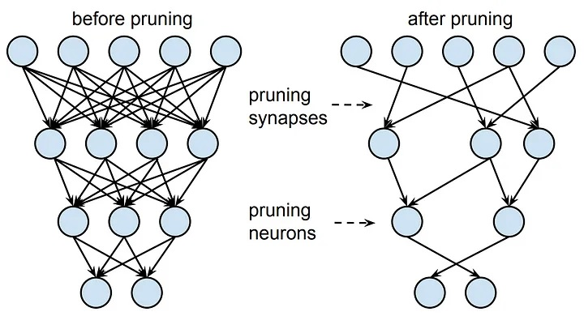
Reduce runtime - pruning
remove redundant neurons
remove rarely activated neurons

Slide 16
Reduce runtime - Results
Model | Learntime | #Param (in Mio) |  | testtime | iterative complete | relative |  | testtime | oneshot complete | relative
64, 64, 64, 128 | 7214 | 7.6 |  | 257.72 | 1 | 1 |  | 6.32 | 0 | 0.70
64, 64, 128 | 1581 | 7.6 |  | 223.99 | 1 | 1 |  | 5.11 | 0 | 0.72
64, 64, 128 P | 2529 | 7.6 |  | 252.42 | 1 | 1 |  | 6.08 | 0 | 0.72
64 ,64 | 1010 | 3.8 |  | 215.86 | 1 | 1 |  | 4.82 | 0 | 0.70
32, 32 | 575 | 1.9 |  | 211.36 | 0.96 | 0.64 |  | 5.10 | 0 | 0.67
16, 16 | 366 | 0.9 |  | 210.96 | 1 | 1 |  | 5.07 | 0 | 0.70
16, 16 P | 467 | 7.6 |  | 220.55 | 1 | 1 |  | 5.35 | 0 | 0.70
8, 8 | 259 | 0.5 |  | 209.18 | 0 | 0.47 |  | 4.97 | 0 | 0.52
64 | 783 | 3.8 |  | 215.60 | 0 | 0.31 |  | 4.97 | 0 | 0.35

Slide 17
Reduce runtime - Result & followup measures
model reduction without losing accuracy is possible
BUT: reducing model complexity had a low effect on testtime
use better Pruning methods
time is lost in the interactive process due to array methods?
enhance by using faster array methods
go for the oneshot approach
make larger models and prune them
Is it possible to reach 100% with this approach?

Slide 18
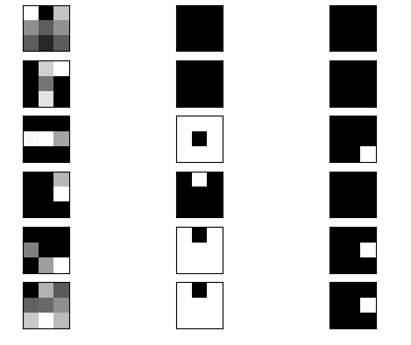
Picture of first 6 filters
black means low activation
white high activation

Slide 19
Lessons learned
Get a better understanding at reading error messages
Good looking learning curve doesn’t automatically mean good predictions
Shaping is a pain!
What is a tensor and what is a numpy array?
Training takes time
Batch size matters
AI is not the solution to everything
ChatGPT is better in generating a classical backtracking solution than solving sudokus itself

Slide 20
The End
Questions?

